Slide 1
Week 10/11: NP-Completeness
CS 5800 Dr. Alan Jamieson

Slide 2
What’re we talking about?
What is NP-completeness?
SAT & 3-SAT
TSP
How do we show that something is NP-complete?
Approximation algorithms
Randomized algorithms

Slide 3
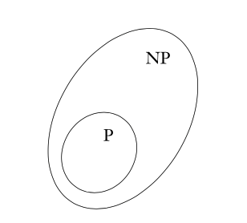
NP-Completeness
NP: classification of languages (read: problems) that can be solved via a non-deterministic Turing machine in polynomial time.
This is in contrast to P - solved using a deterministic Turing machine
From Sipser:

Slide 4
NP-completeness
Introduced by Stephen Cook and Leonid Levin (the Cook-Levin Theorem), NP-completeness is a subset of NP problems where the problem is in NP and every problem in NP is poly-time reducible to B (more on this later).
Showing a problem is NP is straightforward - show a poly-time verifier for the problem.
Basically, give a poly-time algorithm that checks if a potential solution is an actual solution. NOTE: this is not something that generates a solution, just checks one.

Slide 5
For instance:
CLIQUE = {<G, k> | G is an undirected graph with a k-clique}
A clique is a subgraph where every vertex in the subgraph is adjacent to every other vertex in the subgraph.
Solution (a.k.a. certificate): The proposed clique CP = (CV, CE). Verifier: Check that |CV| = k. Check that for all v ∈ CV there exists an edge vw ∈ CE for all w ∈ CV - {v}.
How long does each step take?

Slide 6
SAT & 3-SAT
In order to use the definition of NP-completeness to show a problem is NP-complete, we need a starting, origin problem to work from.
Enter SAT - satisfiability.
SAT = { <ɸ> | ɸ is a satisfiable Boolean formula}
SAT is NP-complete and proven to be as part of the Cook-Levin Theorem.
3-SAT is the same problem but where ɸ is formatted in 3-CNF.

Slide 7
For instance:

Slide 8

Now you:
Take a look at these Boolean equations. Are they satisfiable or not? If they are, provide the satisfiable assignment. (Sipser)

Slide 9
Another classic NP-complete problem
Traveling salesperson problem - given a connected, weighted graph, find a cycle (tour) that passes through every vertex exactly once, with minimum cost.
Some variations include a source vertex (thus the only vertex to be visited twice), or a cost bound (the tour must cost < x).
Another easy problem to state, but harder to solve optimally.

Slide 10
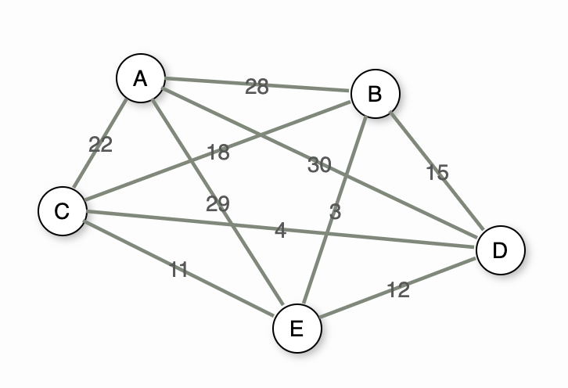
For example:
Notes:
From VaTech’s https://opendsa-server.cs.vt.edu/embed/TSPPRO

Slide 11
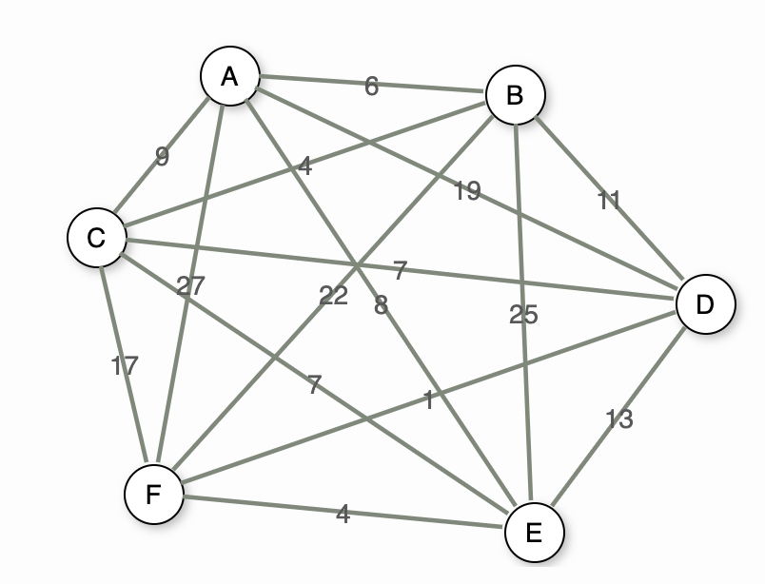
Now you:
For the below graph, give an optimal TSP routing assuming that we start at vertex A.
Notes:
From VaTech’s https://opendsa-server.cs.vt.edu/embed/TSPPRO

Slide 12
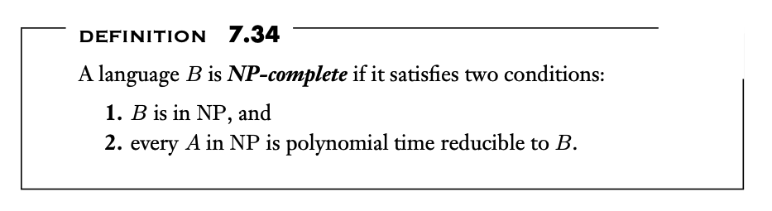
Showing something is NP-complete
“Easy”: (Sipser)

Slide 13
Reductions
Basically, create an algorithm that transforms one problem into another.
For NP-completeness, we want to define a poly-time algorithm that transforms an NP-complete problem that we know already into our target problem.
This sometimes require a transformation of not only the problem, but the input as well.
Note: this appears in chapter 7, but we apply it here.

Slide 14
For example: INDEPENDENT-SET
INDEPENDENT-SET = {<G, g> | G contains an independent set of size g}
To prove INDEPENDENT-SET is NP-complete we’ll use 3-SAT. This seems non-obvious (we could use domination set here for a simpler version, for instance) but it’s how the original proof went.
So: 3SAT ≤_{P} INDEPENDENT-SET
Basically, create a way to convert a 3SAT equation into an equivalent independent set problem!

Slide 15
Wha? How??
Given some instance I of 3-SAT, we create an instance (G, g) of INDEPENDENT-SET:
Graph G has a triangle for each clause, with vertices labeled by the clause’s literals, and has additional edges between any two vertices (across the clauses) that represent opposite literals.
The goal g is set to the number of clauses.

Slide 16
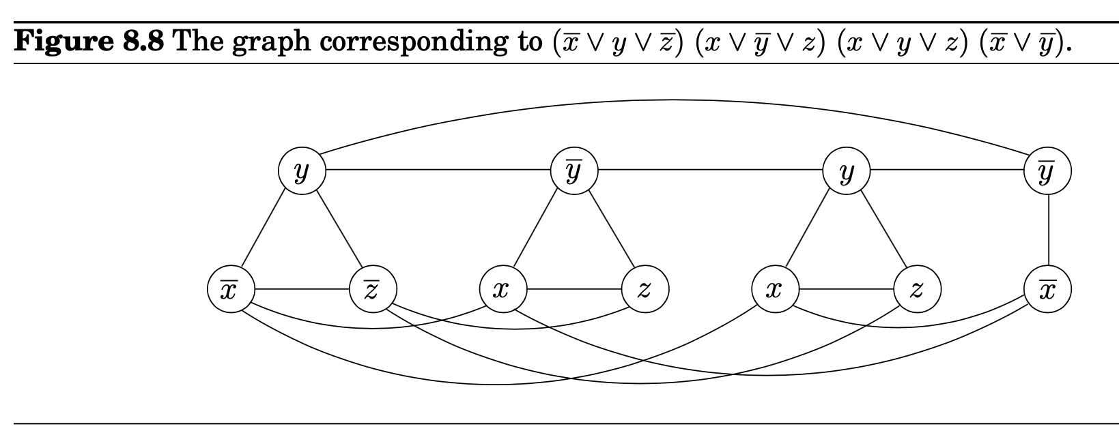

Slide 17
“Proof”
After doing the construction, we need to show a couple of things.
That if there exists an independent set S of size g, then that means there’s a satisfying assignment of the 3SAT equation.
That if there isn’t an independent set S of size g, then that means there’s not a satisfying assignment of the 3SAT equation. (typically, this is done as the contrapositive: if the equation is satisfiable then there exists an independent set of size g).

Slide 18
“Proof”
That if there exists an independent set S of size g, then that means there’s a satisfying assignment of the 3SAT equation.
Proof sketch: note that for any variable x, our independent set S cannot contain both x and ~x due to the edge creation between opposing literals. Since S has g vertices, this forces us to have one vertex per clause (triangle) and due to the restriction above, this means that we create a satisfying assignment based on the vertices chosen.

Slide 19
“Proof”
2.) (Contrapositive) If there exists a satisfying assignment for 3SAT, then there exists an independent set of size g.
Proof sketch: since g is equal to the number of clauses, choose the vertices in each triangle that are set to true as part of satisfying assignment (one vertex per clause). This means that we pick exactly one vertex per triangle, and since we cannot choose opposing vertices, then we have an independent set.

Slide 20
Now you:
Prove that CLIQUE = {G, k | G is an undirected graph with a k-clique} is NP-complete. We already showed that it is in NP, so all you have to do is the reduction!
HINT: try 3-SAT

Slide 21
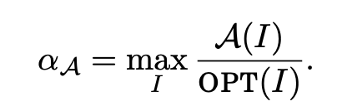
Approximation Algorithms
A classification of solutions for NP-hard problems that might generate an optimal solution occasionally, but are deemed “close enough” for an application.
How do we measure “close enough”? Typically we have an approximation ratio formula like: Where A(I) represents the value out of our approximation algorithm, and OPT(I) represents the value out of the optimal solution for input I. This is also sometimes called c-approximation where c is this ratio 𝛼.

Slide 22
So, how?
Using techniques we already know!
We’ve already seen that some of the techniques we’ve talked about allow us to get a solution very quickly, but does not guarantee optimality.
Which one?

Slide 23
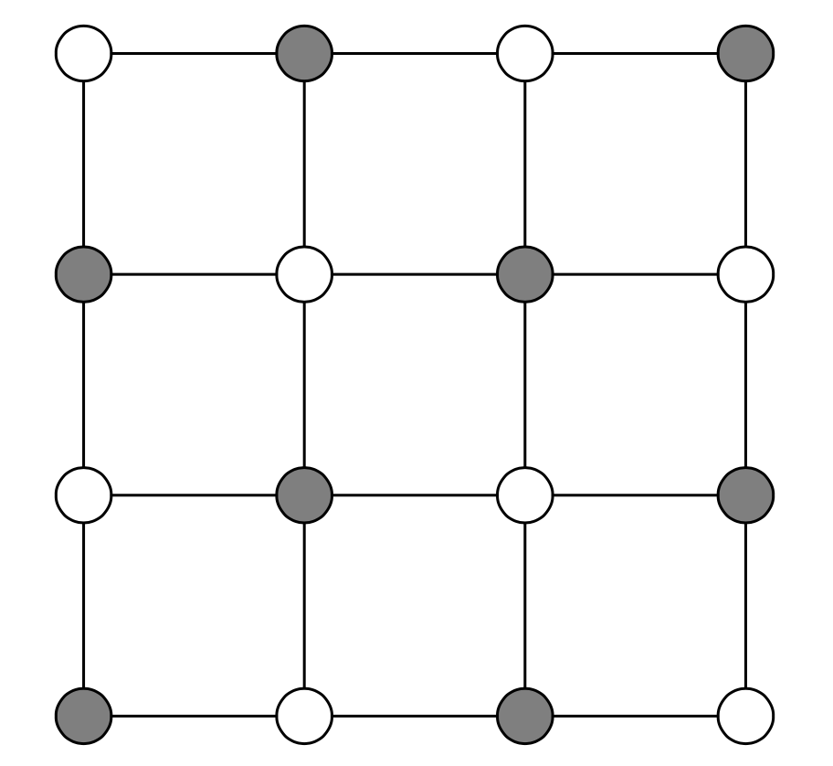
Greedy. Again.
Let’s take a look at an example:
Vertex cover - Given an undirected graph G, choose a subset of vertices S ⊆ V s.t. each edge is incident to a vertex in S. Minimize |S|.

Slide 24
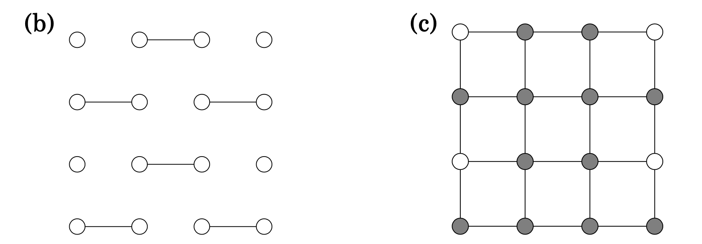
Greedy solution?
One approach is to note that a maximal matching gives us a vertex cover if we take all of the end points to be in S. So, do greedy maximal matching!

Slide 25
Analysis?
Clearly, this isn’t optimal. In our approximation case, we get a |S| = 12, while in an earlier example |S| = 8. This technique gets us an |S| that could be up to 2 times the size of the optimal set. So, we have a 2-approximation with just this technique!
Notes:
Complete bipartite graph could end up with a 2n solution by choosing the maximal matching of the edges connecting across (netting 2n vertices) while the optimal solution is just choosing one side of edges in the graph.

Slide 26
Another example?
Traveling salesperson - restated, get the salesperson around our graph and back to our starting vertex without visiting anything twice, and do it in the smallest amount of time/distance/etc.
Approximation algorithm?

Slide 27
Approximation algorithm for TSP
Create a minimum spanning tree of our graph.
Create a traversal of our MST.
Trim out of the traversal any repeated vertices. This becomes our actual tour that we will attempt.
Turns out that this yields a 2-approximation assuming that the graph follows the triangle inequality and can be mapped to an actual surface. If we’re allowed to cheat by creating shortcuts, this gets better.

Slide 28
Now you:
Develop an approximation algorithm to find the minimum total dominating set of a graph G. What’s the approximation ratio of your solution?
Total domination - Given a graph G = (V, E), a total dominating set S ⊆ V is a set where ∀v ∈ V, v is adjacent to a member of S.

Slide 29
Randomized Approximation Algorithms
One other way to approach this is to do a variation of approximation using randomized algorithms.
Classically, this is a way to generate solutions very quickly, but really non-optimally.
BUT - the algorithm can be built to preserve most of the speed, but set conditions on the random generation.
What this is not: Monte Carlo or Las Vegas algorithmic simulation where we exploit probability and iteration to get a high confidence (though there are some approximation algorithms that use Monte Carlo).

Slide 30
Example:
Maximum Independent Set - what would a randomized algorithm look like for this?
Randomly pick an vertex, check adjacency, if not adjacent, add to S.
What would the approximation ratio look like for this algorithm? Could be real bad! Consider a star graph.
Could we do better? What kind of restrictions do we need?

Slide 31
Now you:
Using a randomized approximation approach, develop an algorithm to solve SAT. What is the approximation ratio for your algorithm?
Now, do it again, but for the vertex cover problem we discussed before. What is the approximation ratio for this algorithm?

Slide 32
Other options
There are, of course, multiple other options here including:
Randomized hill climbing, simulated annealing
Branch-and-bound
Quantum algorithms
Genetic algorithms with a cutoff
Reducing the input size and solving it exhaustively

Slide 33
On your radar:
Synthesis #3: due December 6th
Final project stuff: due December 9th, 1pm eastern
Final presentations (mandatory attendance): December 9th, 1pm
Stuff to talk about:
TRACE
The final session itself
Next two weeks

